Slide 1



Data Analysis on AdventureWorks2014 By SQL and Python

Slide 2

🎯 Objective
Analyze AdventureWorks2014 data to uncover actionable business insights related to:
Sales performance
Customer behavior
Product trends
Time-based patterns
📊 Dataset Summary
Source: Microsoft AdventureWorks2014 (SQL Server)
Tables Used:
SalesOrderHeader, SalesOrderDetail, Product, Customer, Employee, Person
Data Types: Sales, customers, employees, shipping, products

Slide 3
Project Workflow
🔗 Step 1: Connect to SQL Server from Python
📦 Step 2: Sales & Product Analysis
👥 Step 3: Customer & Region Insights
Step 4: Employees & Performance
⏰ Step 4: Time-Based & Trend Analysis
💡 Step 5: Key Insights & Business Value

Slide 4
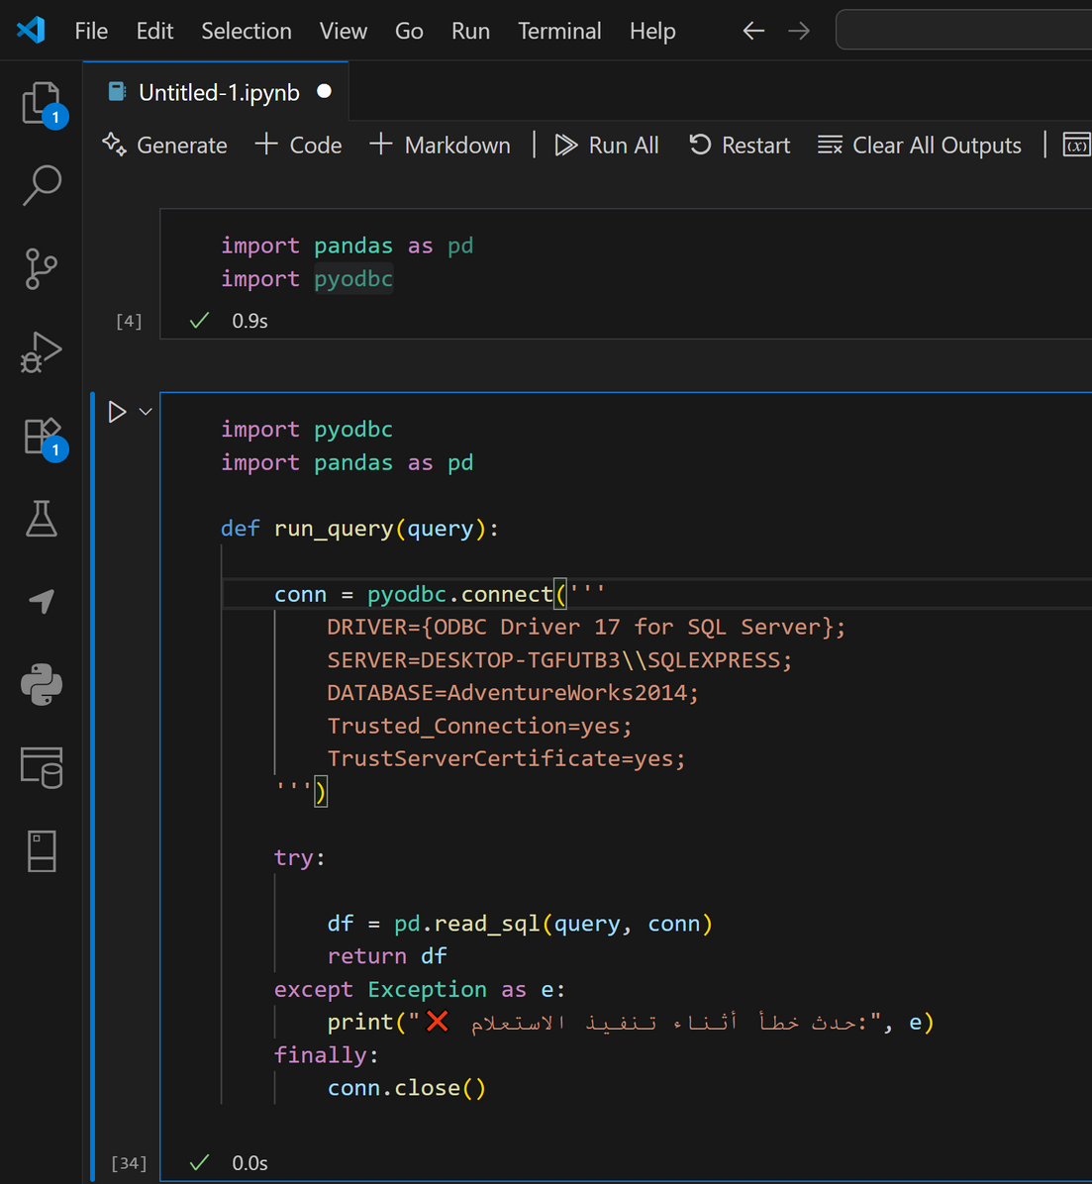
🔗 Step 1: Connect to SQL Server from Python

Slide 5
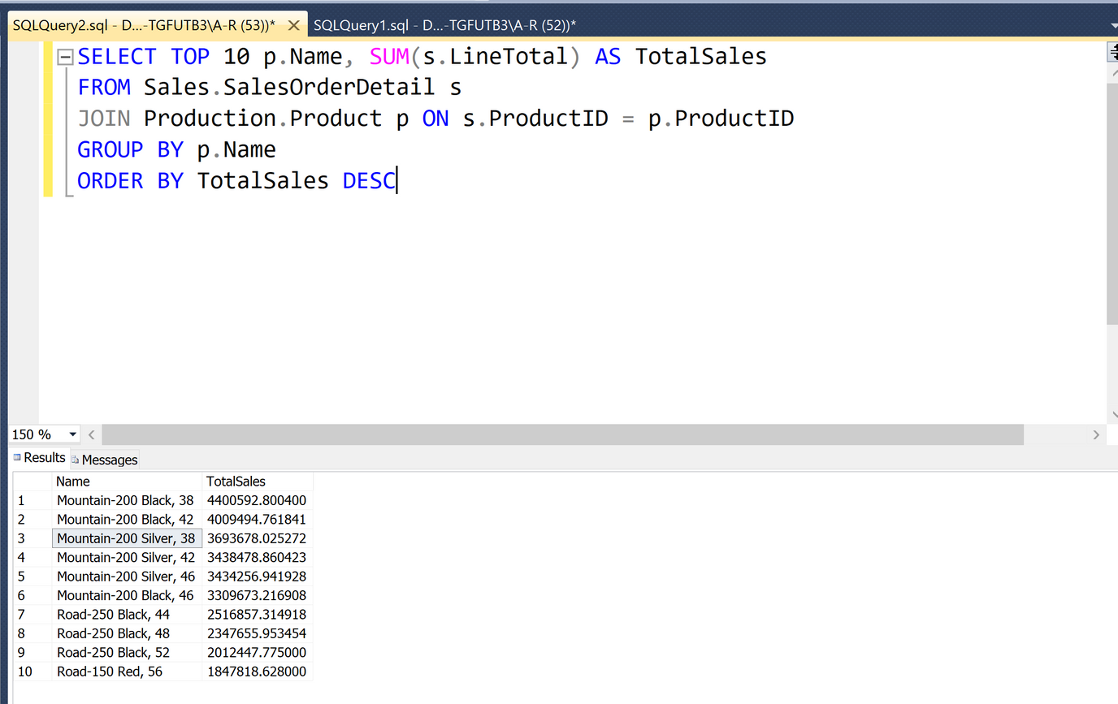
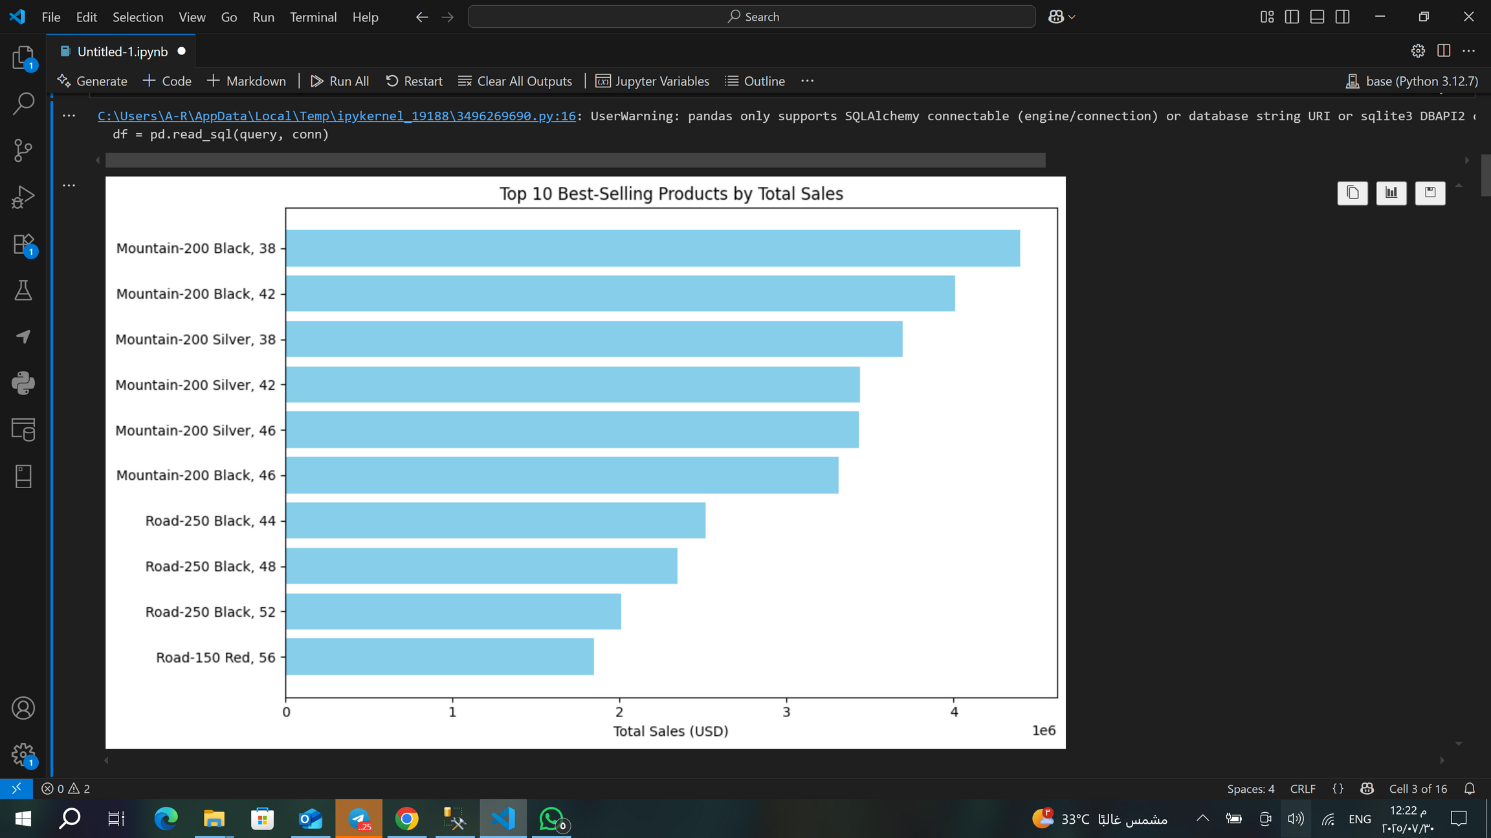
📦 Step 2: Sales & Product Analysis
1.What were your best-selling products last year?

Slide 6
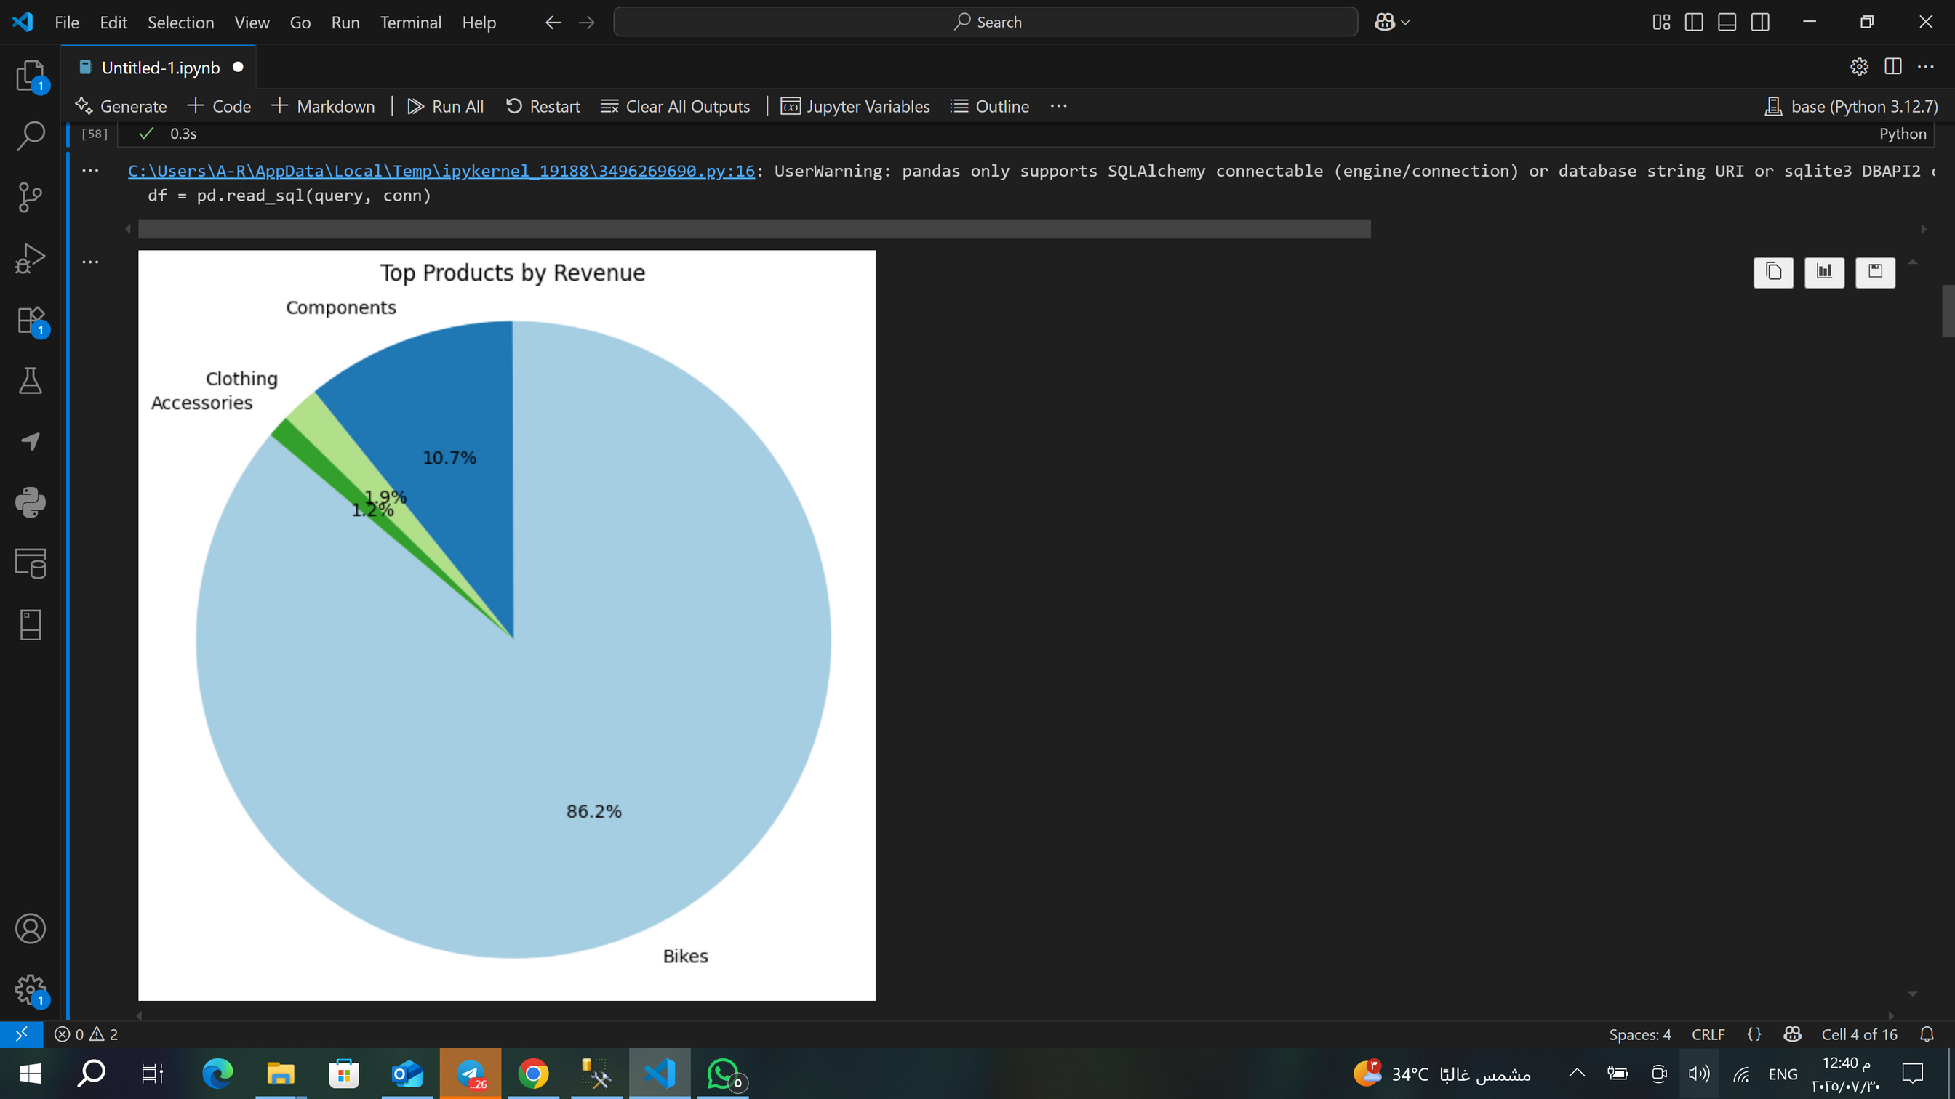
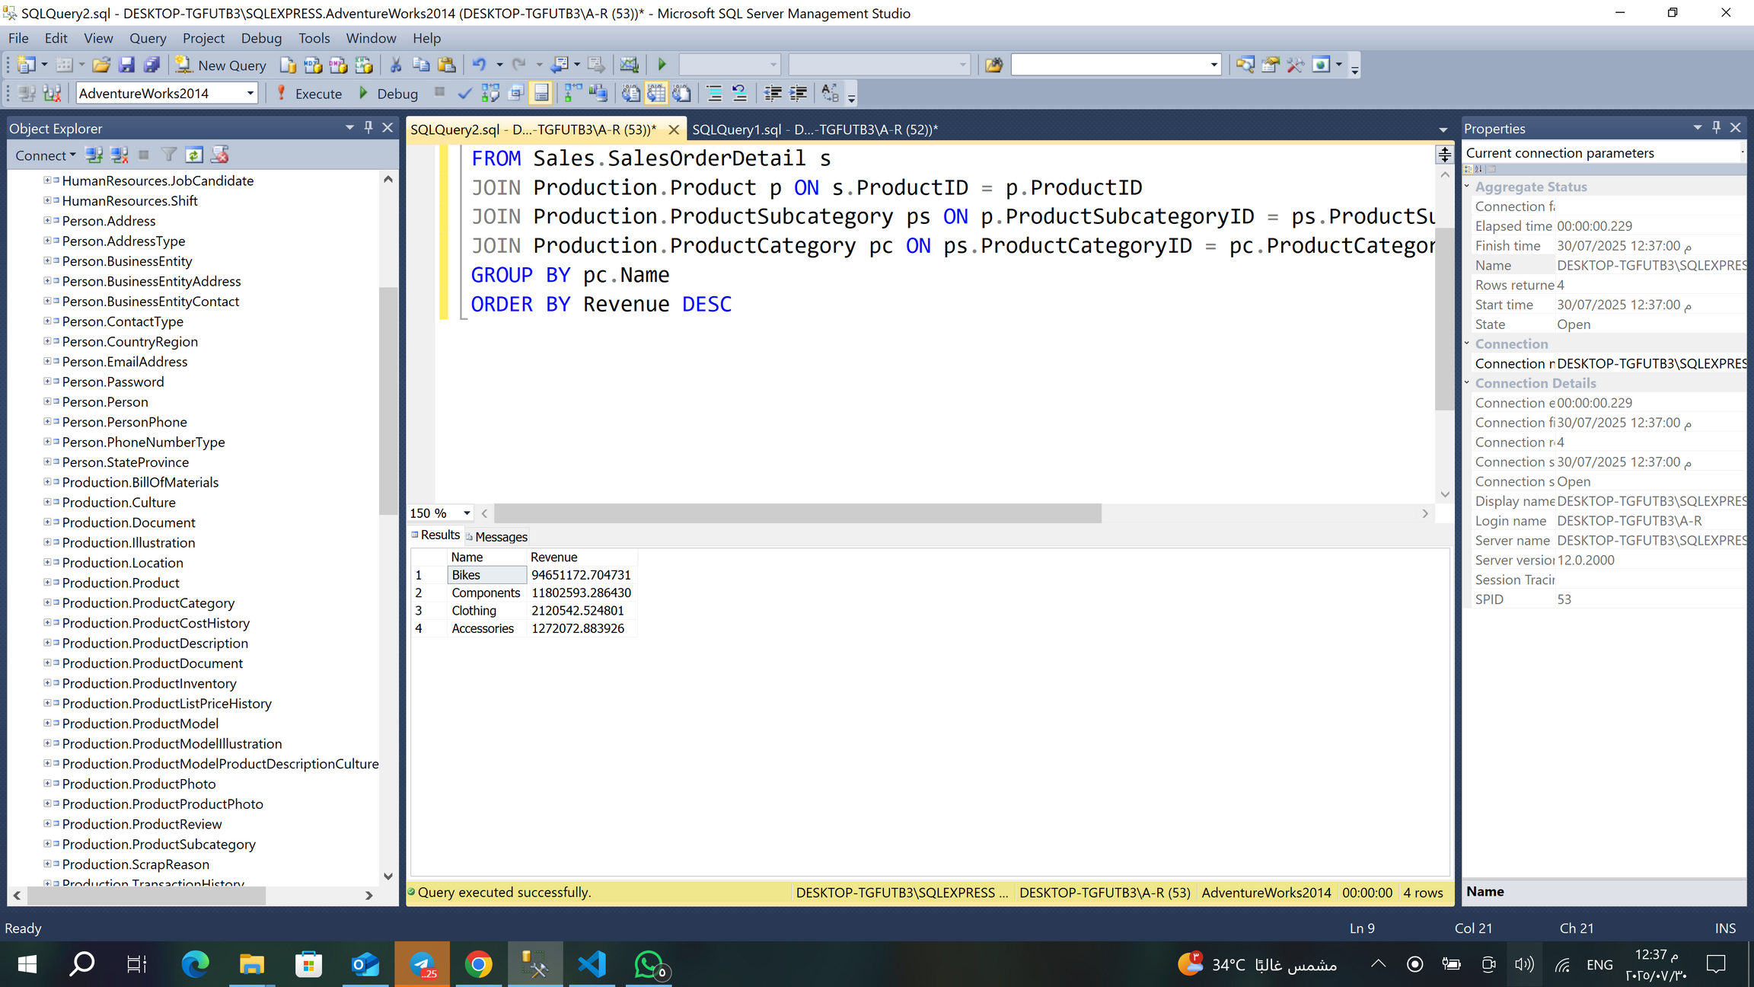
What is the highest revenue generating category?

Slide 7
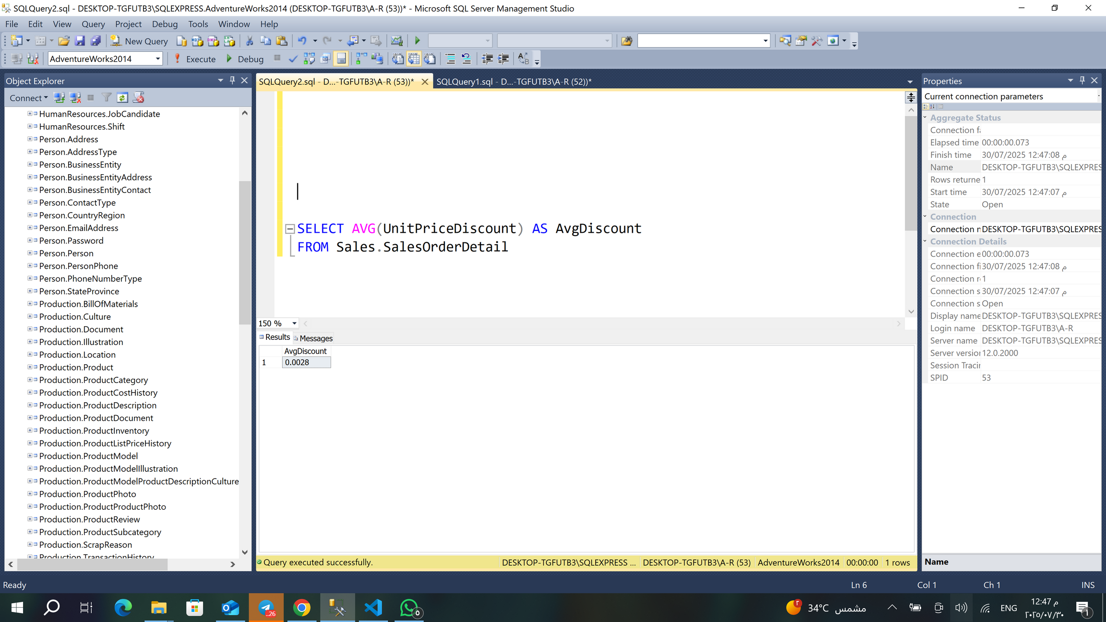
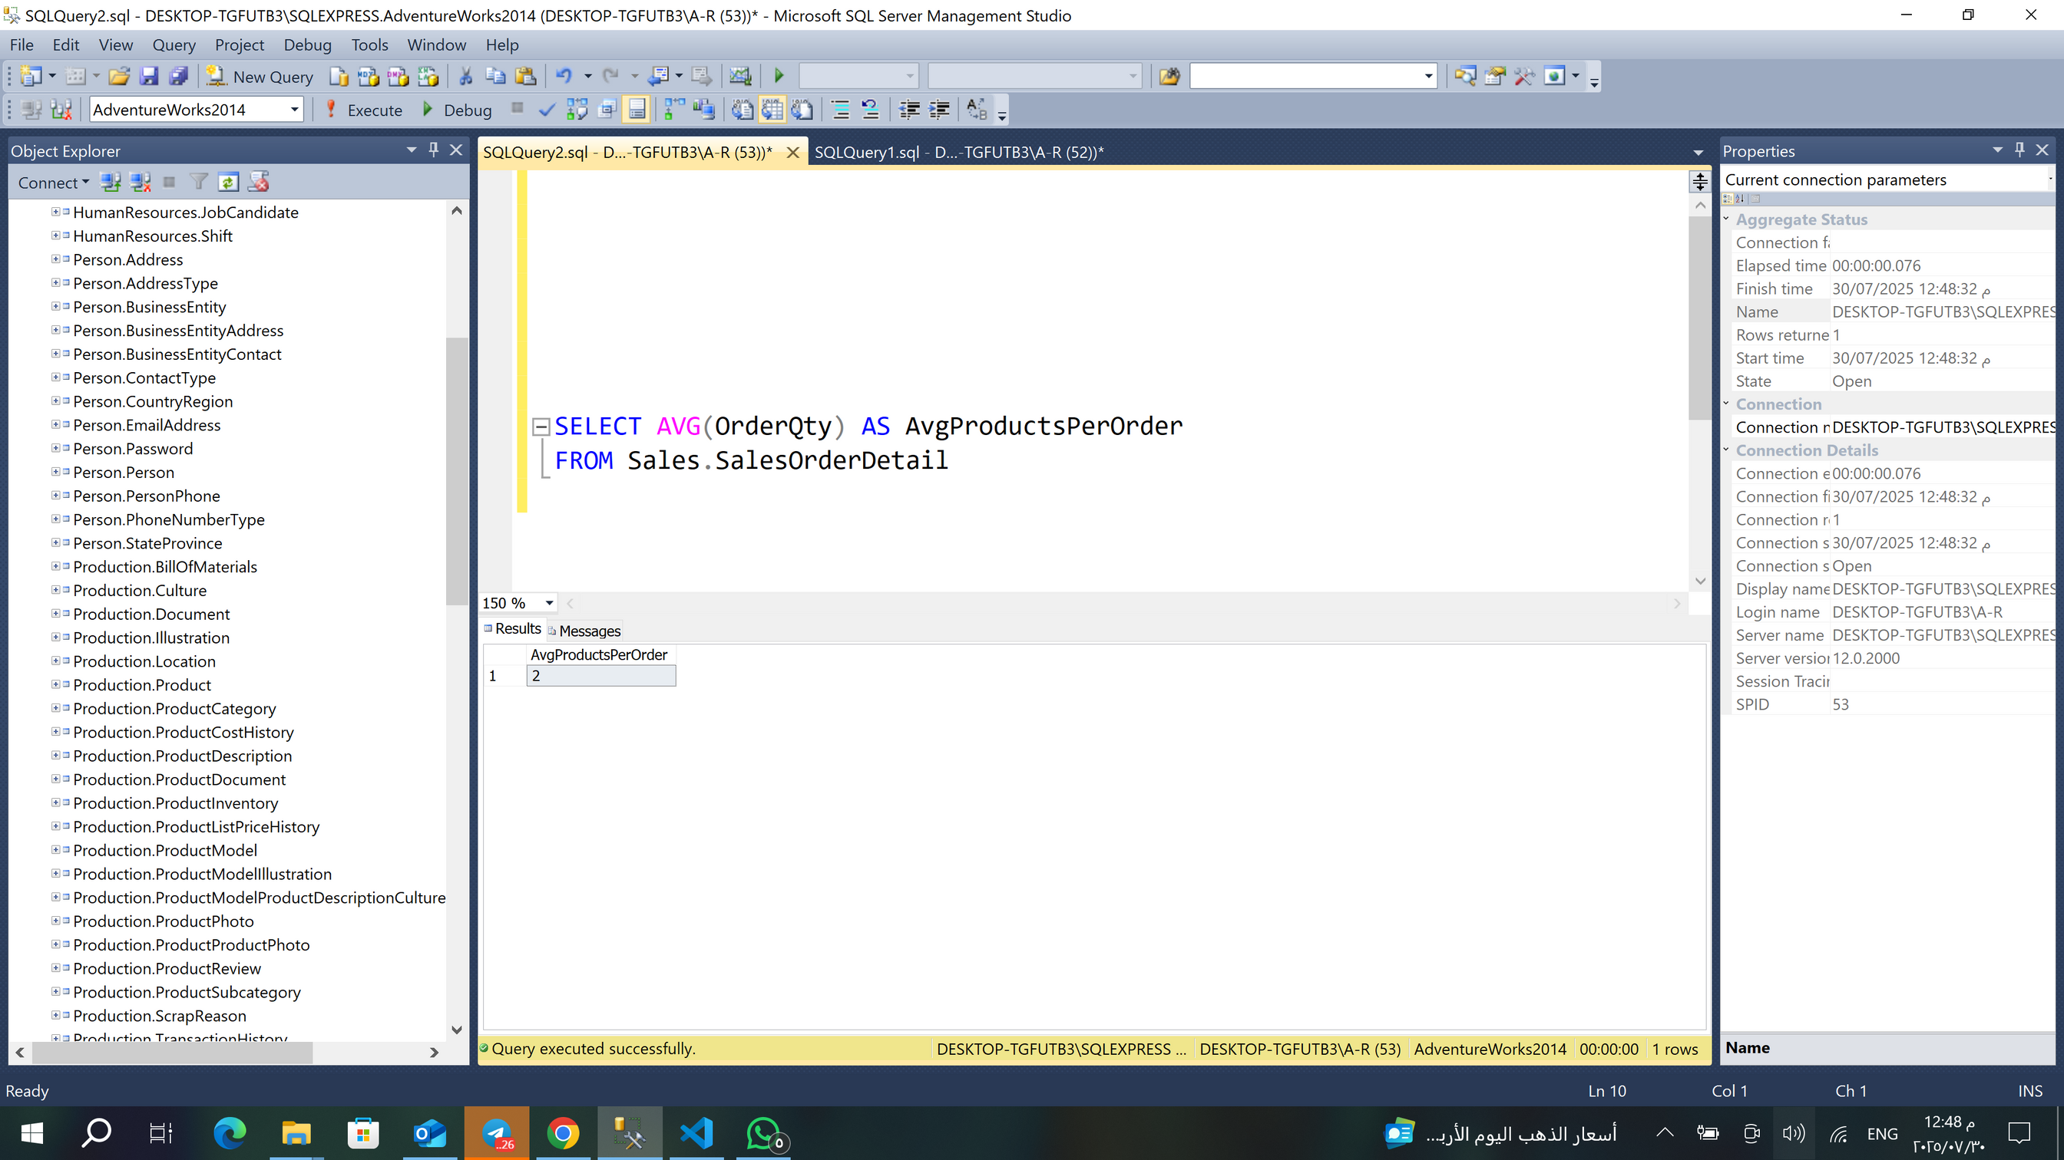
What is the average discount that customers get?
What is the average number of products in each order?

Slide 8
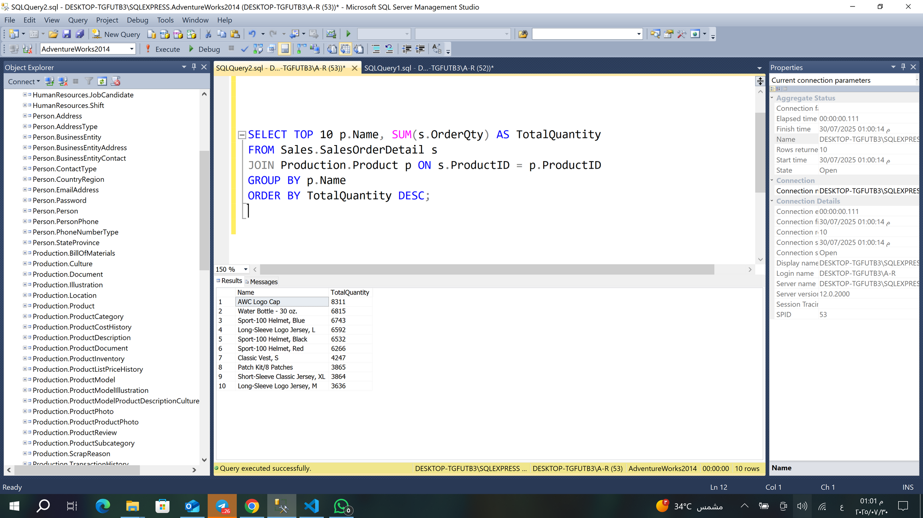

Which products have the highest quantity sold?

Slide 9
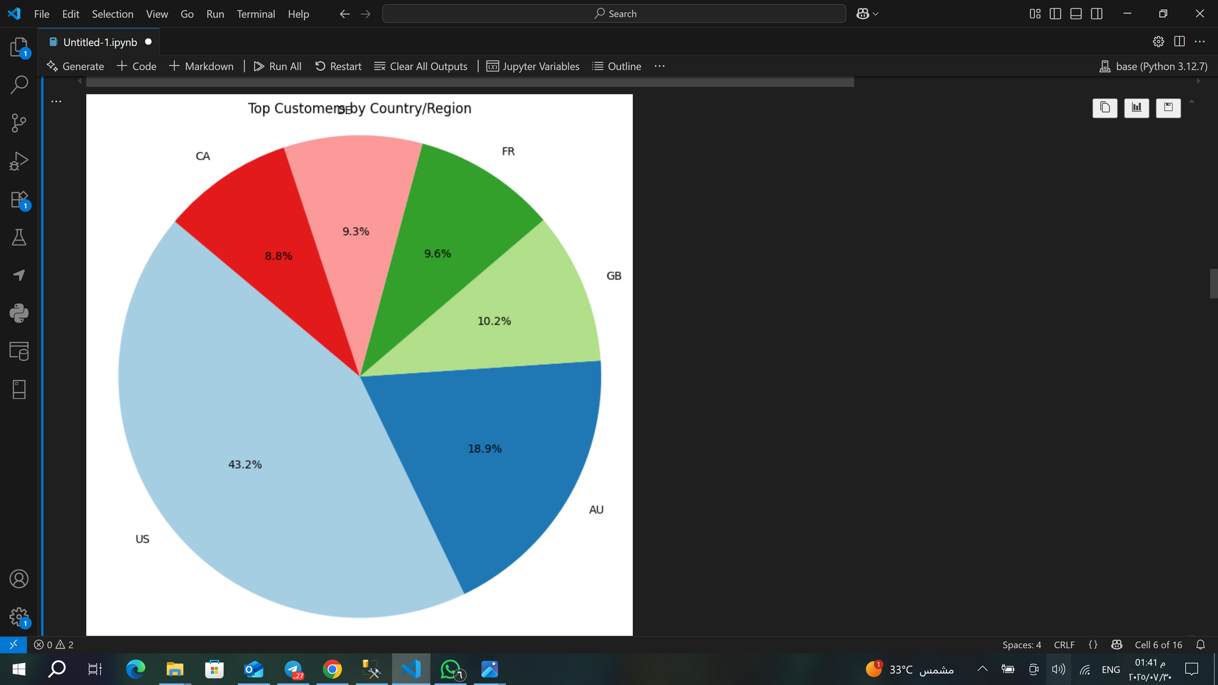
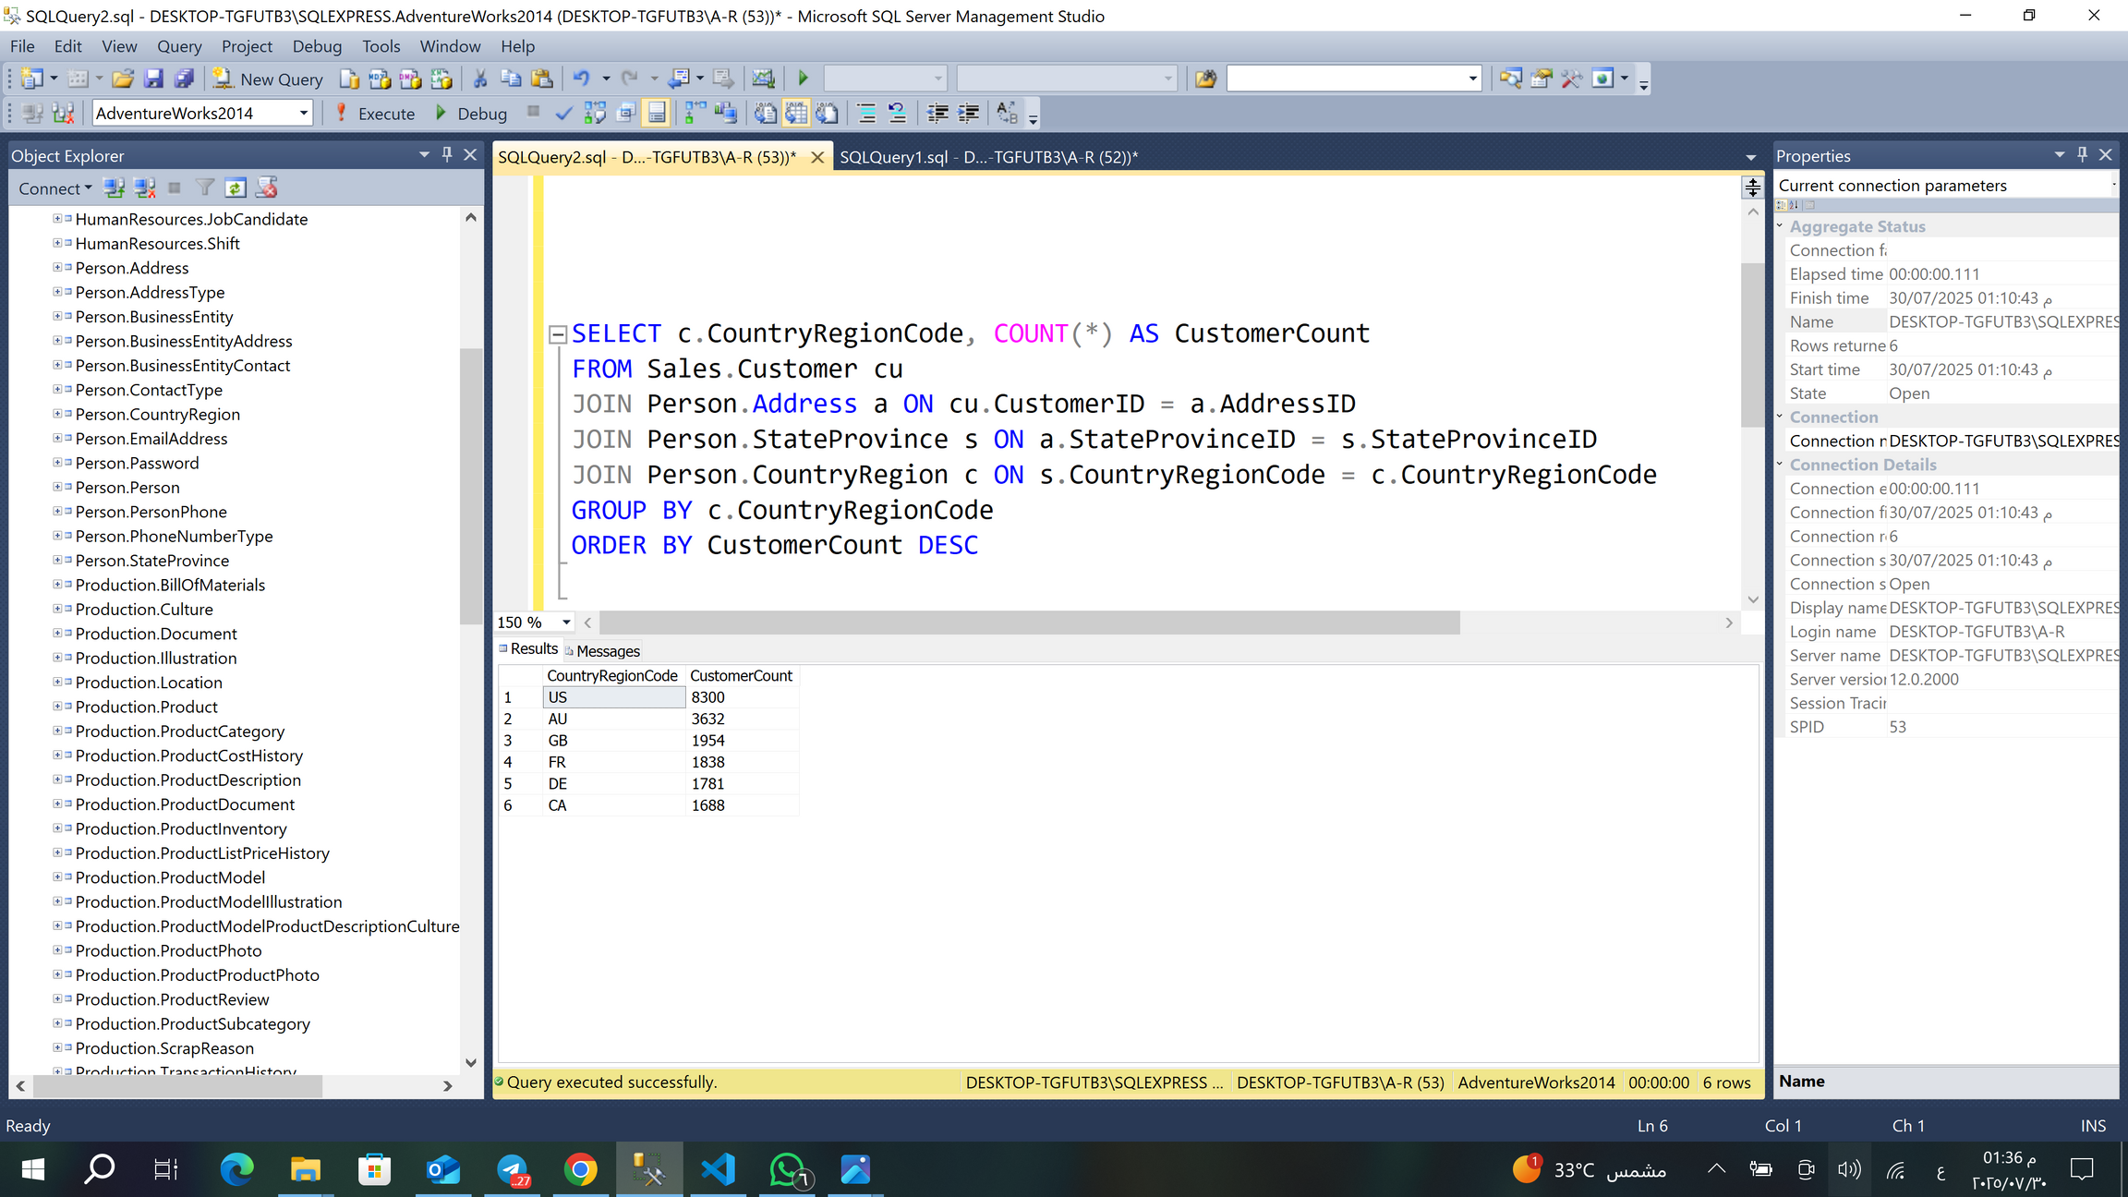
👥 Step 3: Customer & Region Insights
Which countries have the most customers?

Slide 10
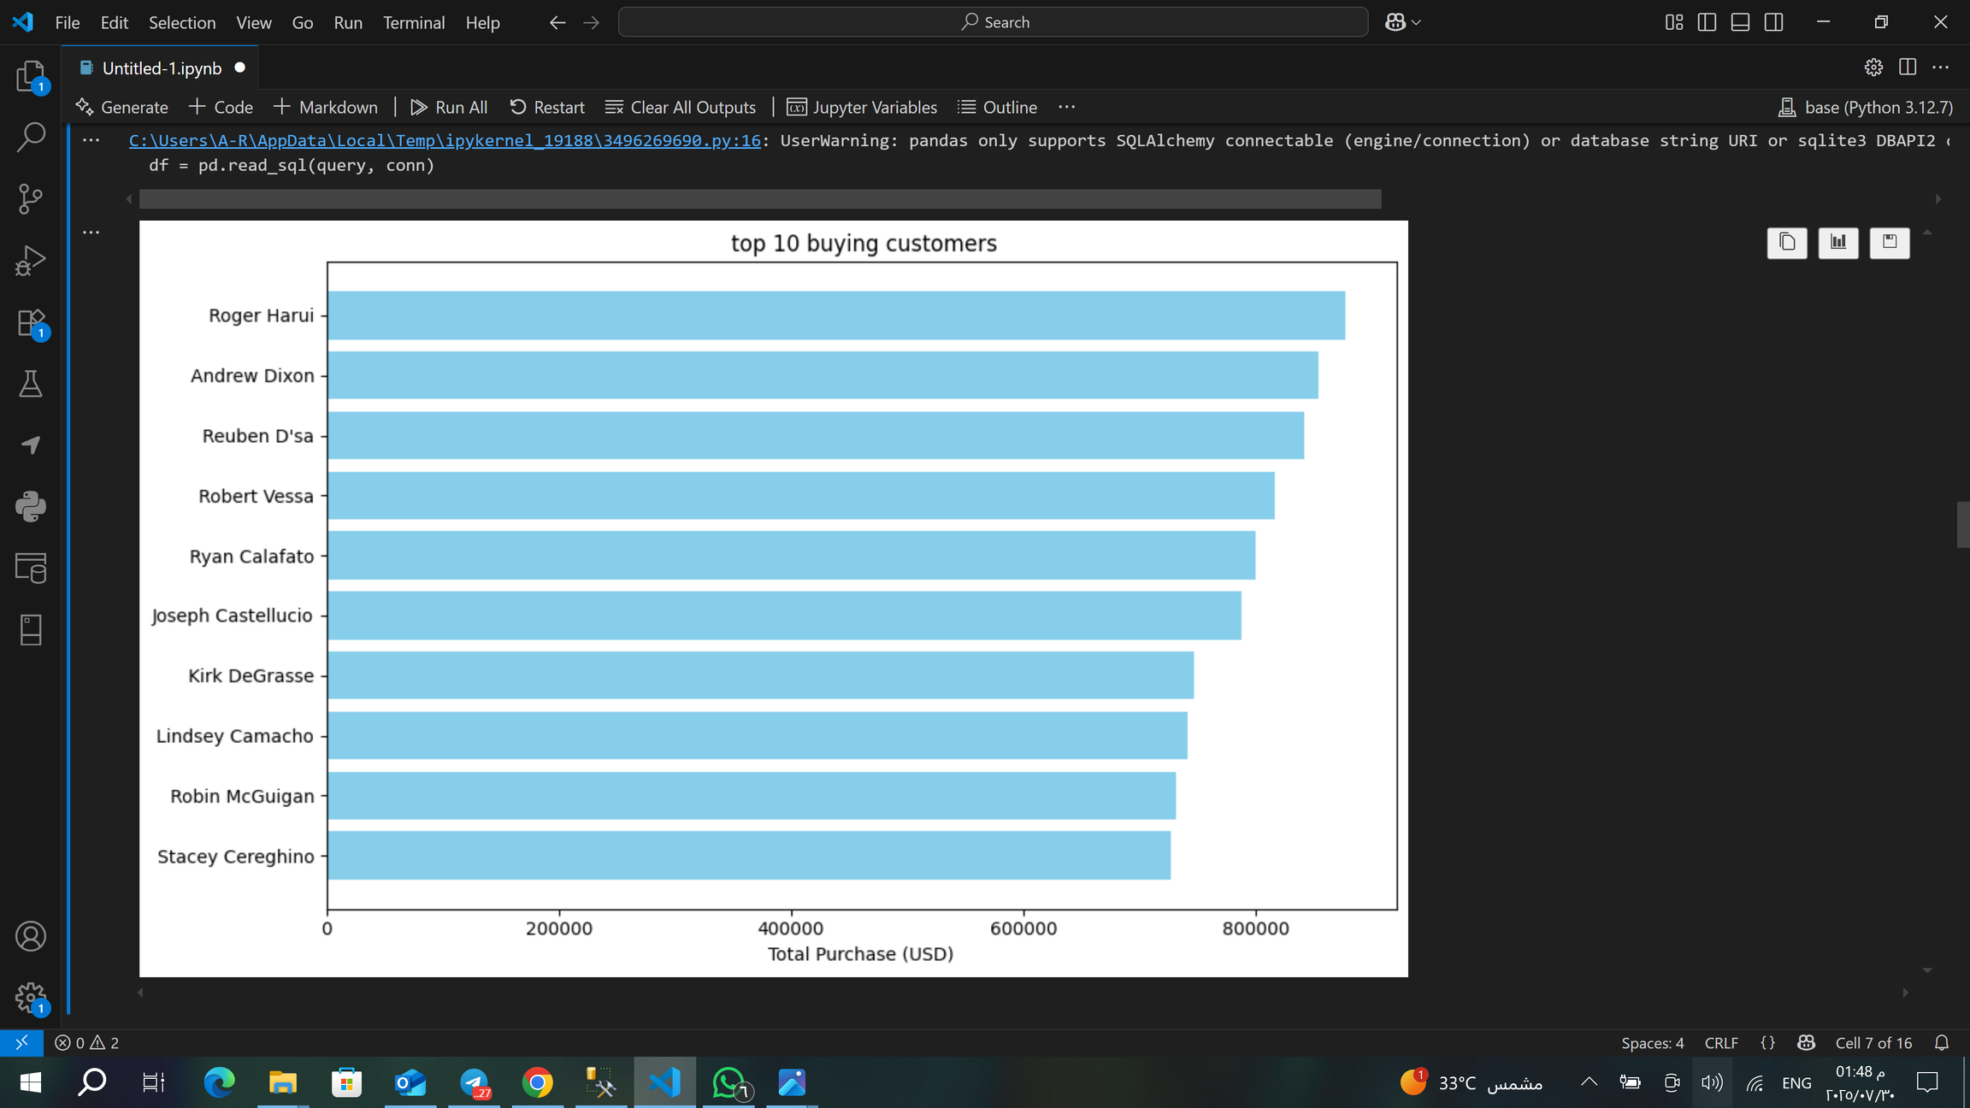
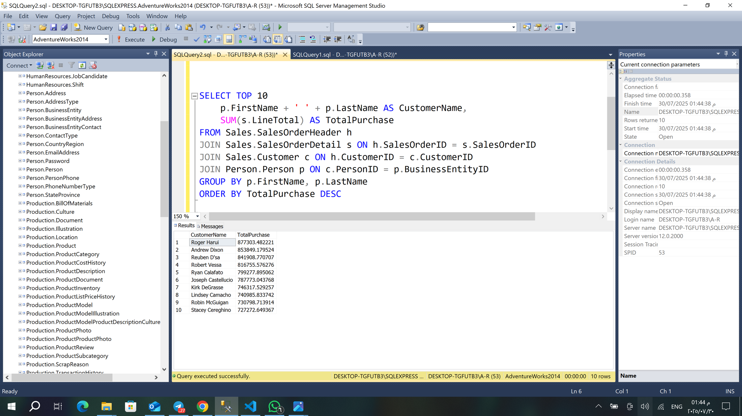
Who are your top 10 buying customers?

Slide 11
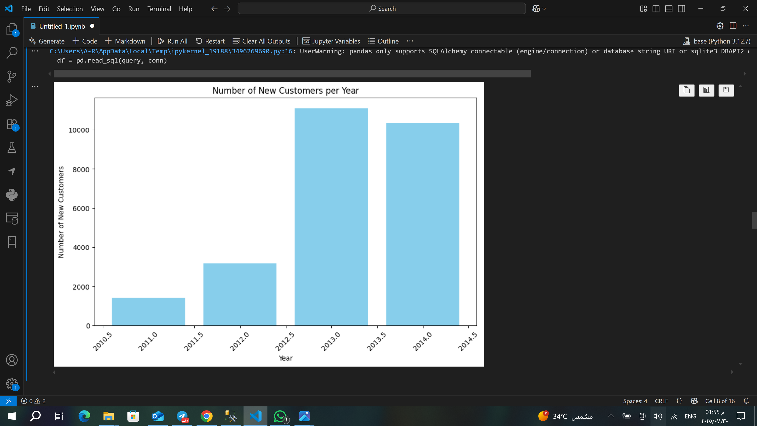
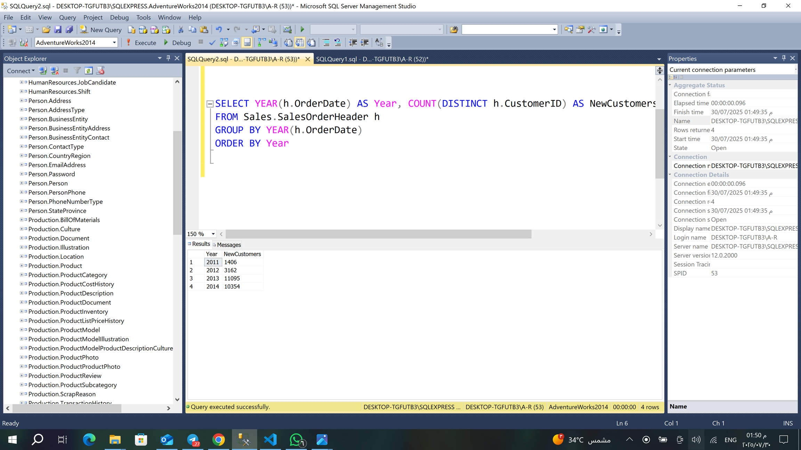
How many new customers per year?

Slide 12
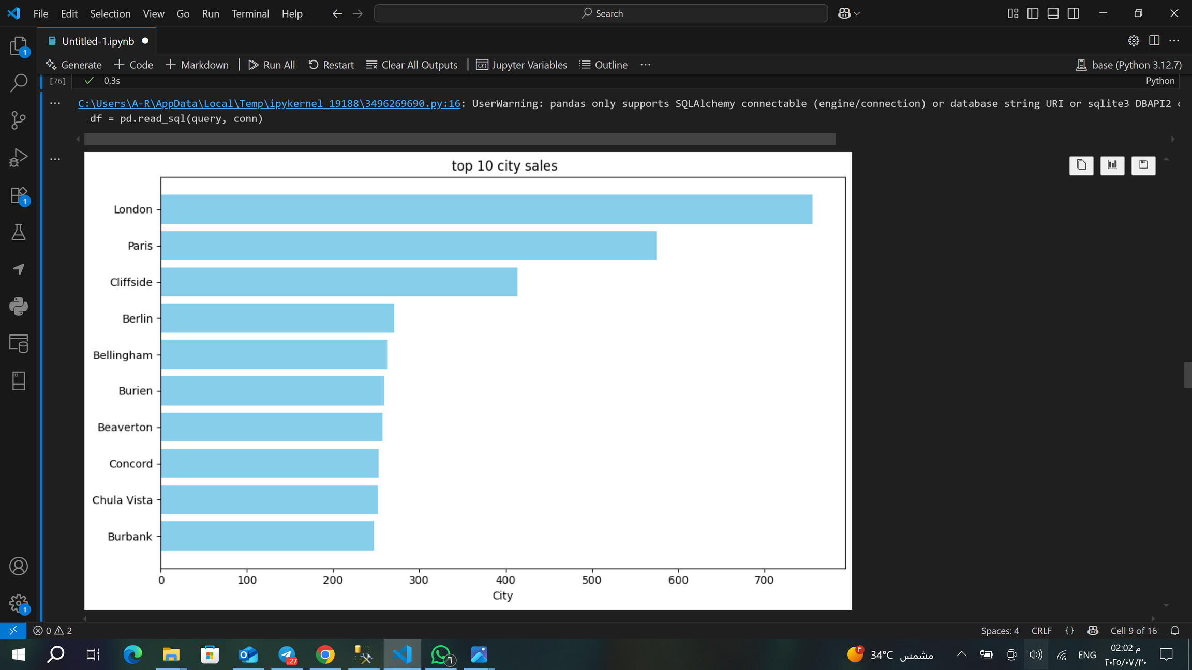
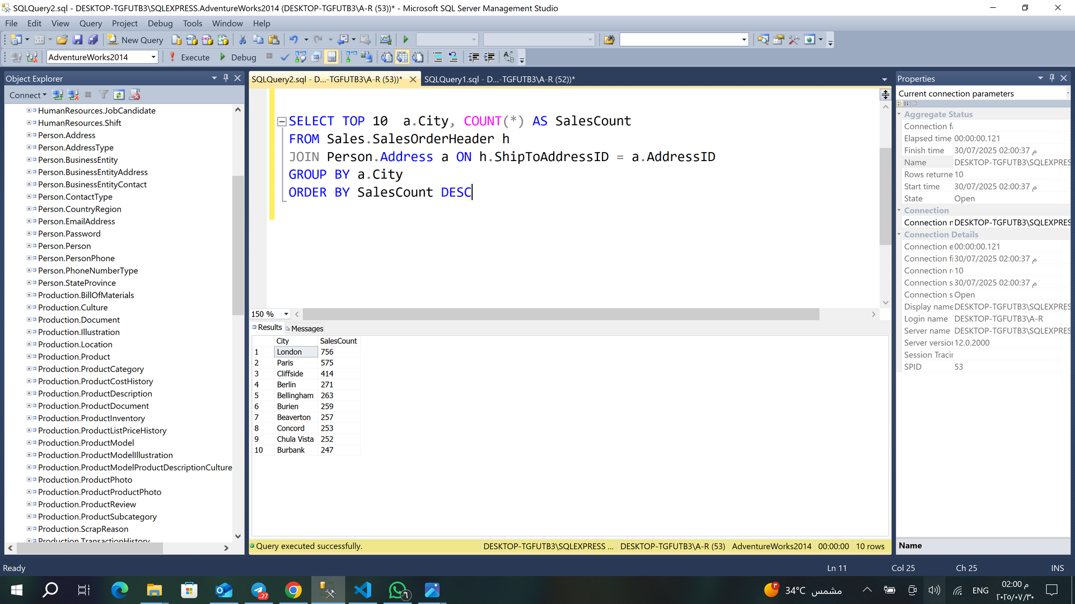
Which cities have the most sales?

Slide 13
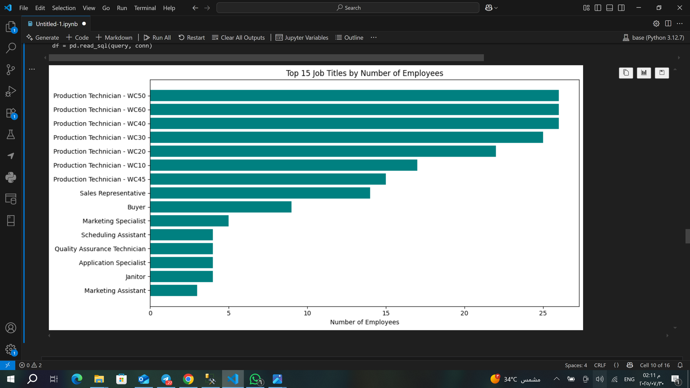
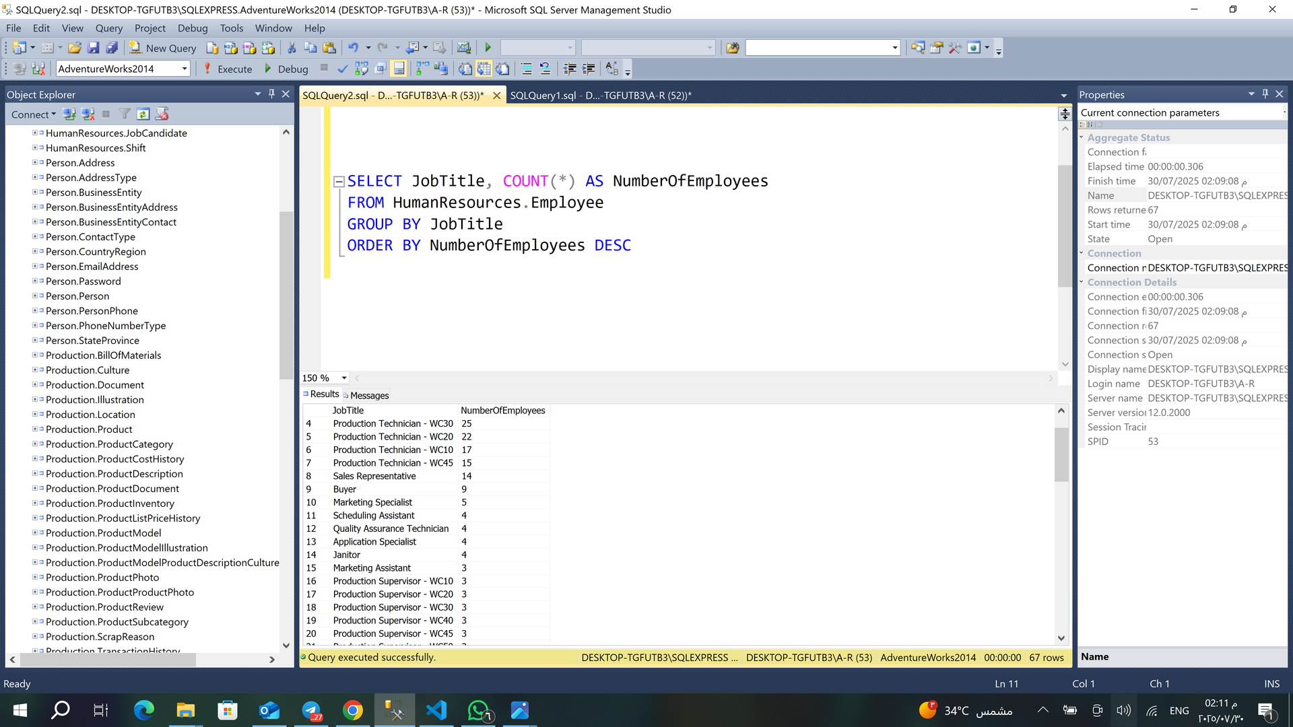
Step 4: Employees & Performance
What is the job distribution in the company?

Slide 14
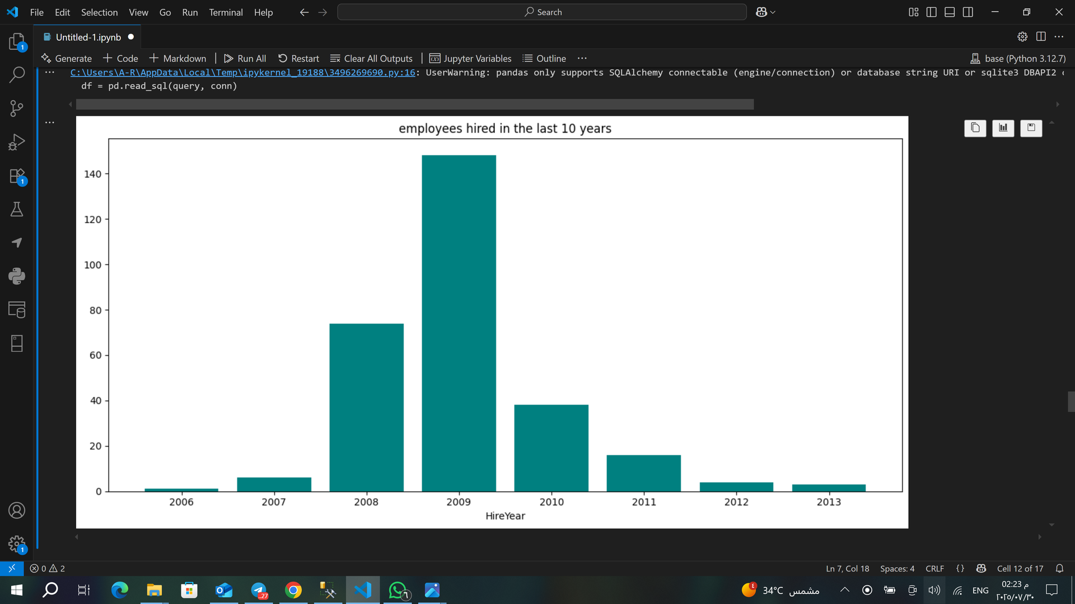
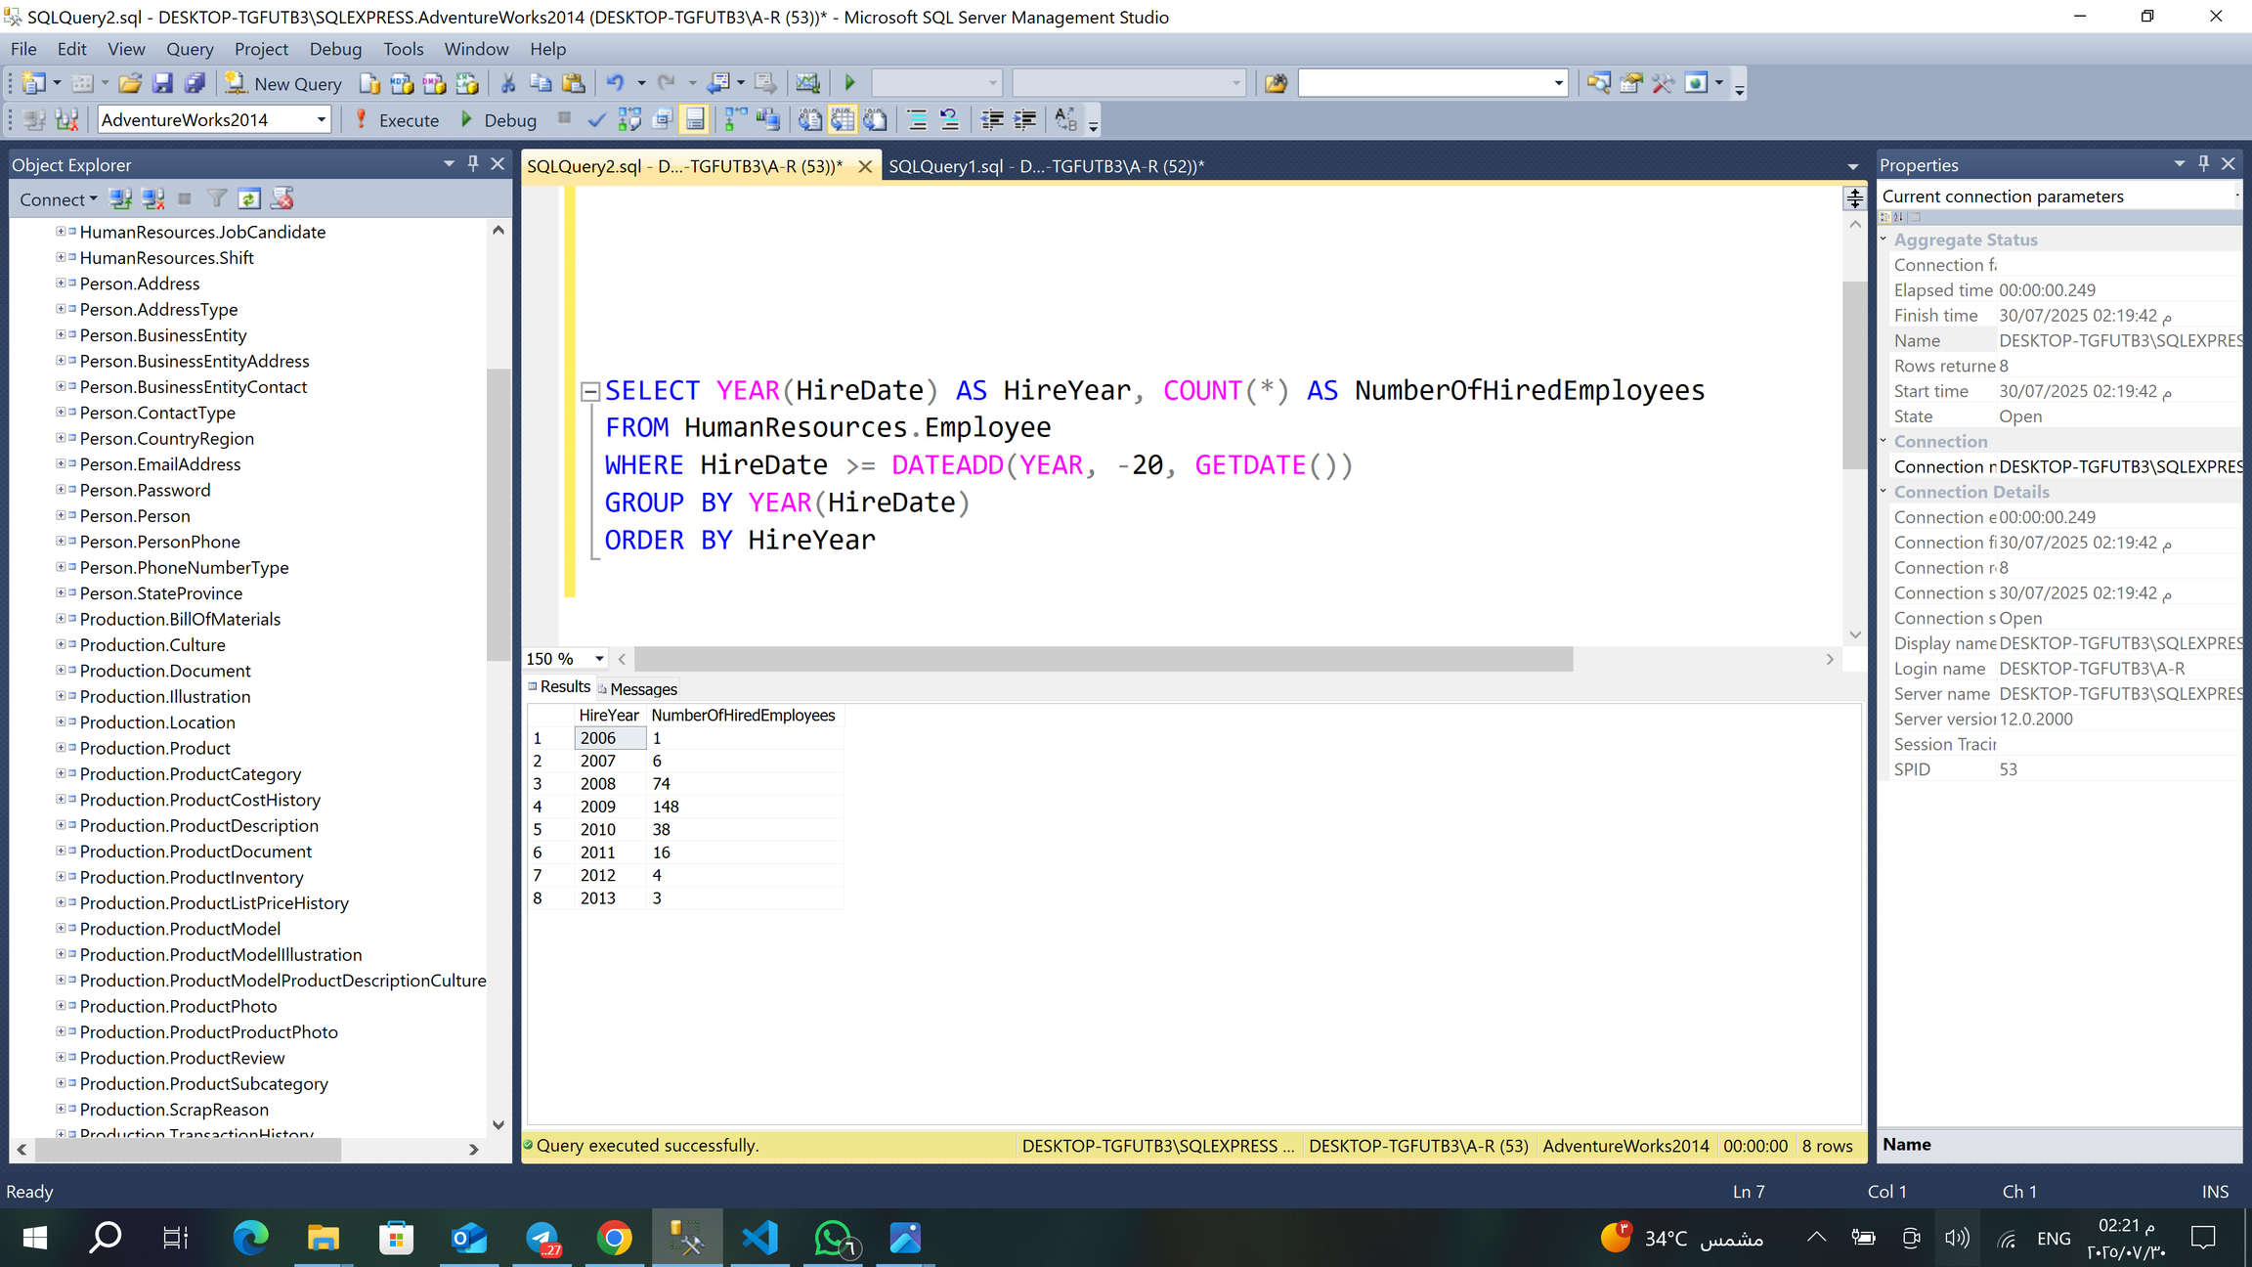
How many the employees hired in the last 10 years?

Slide 15
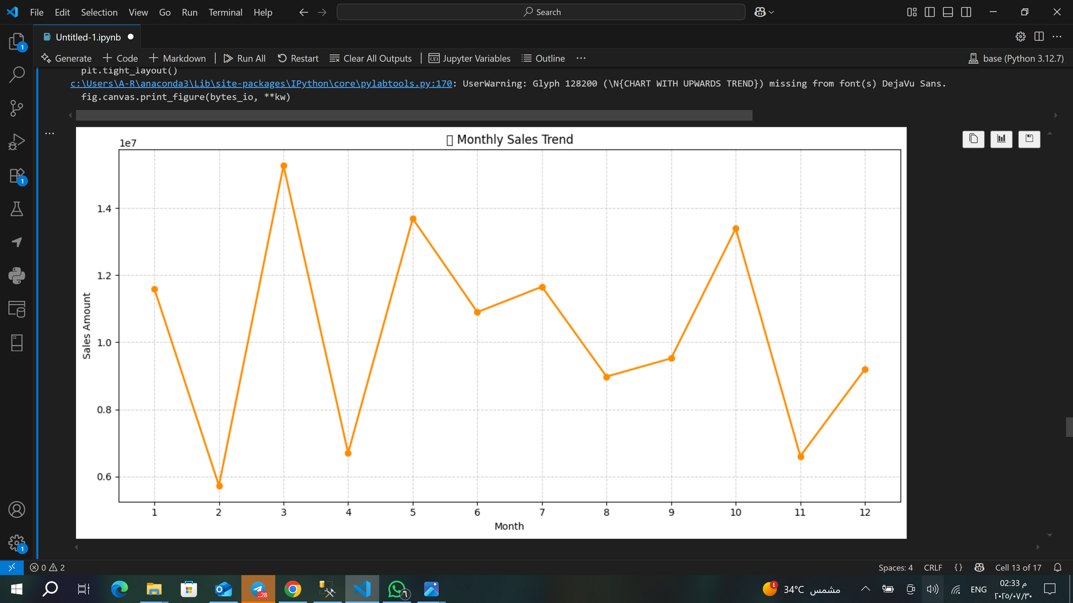
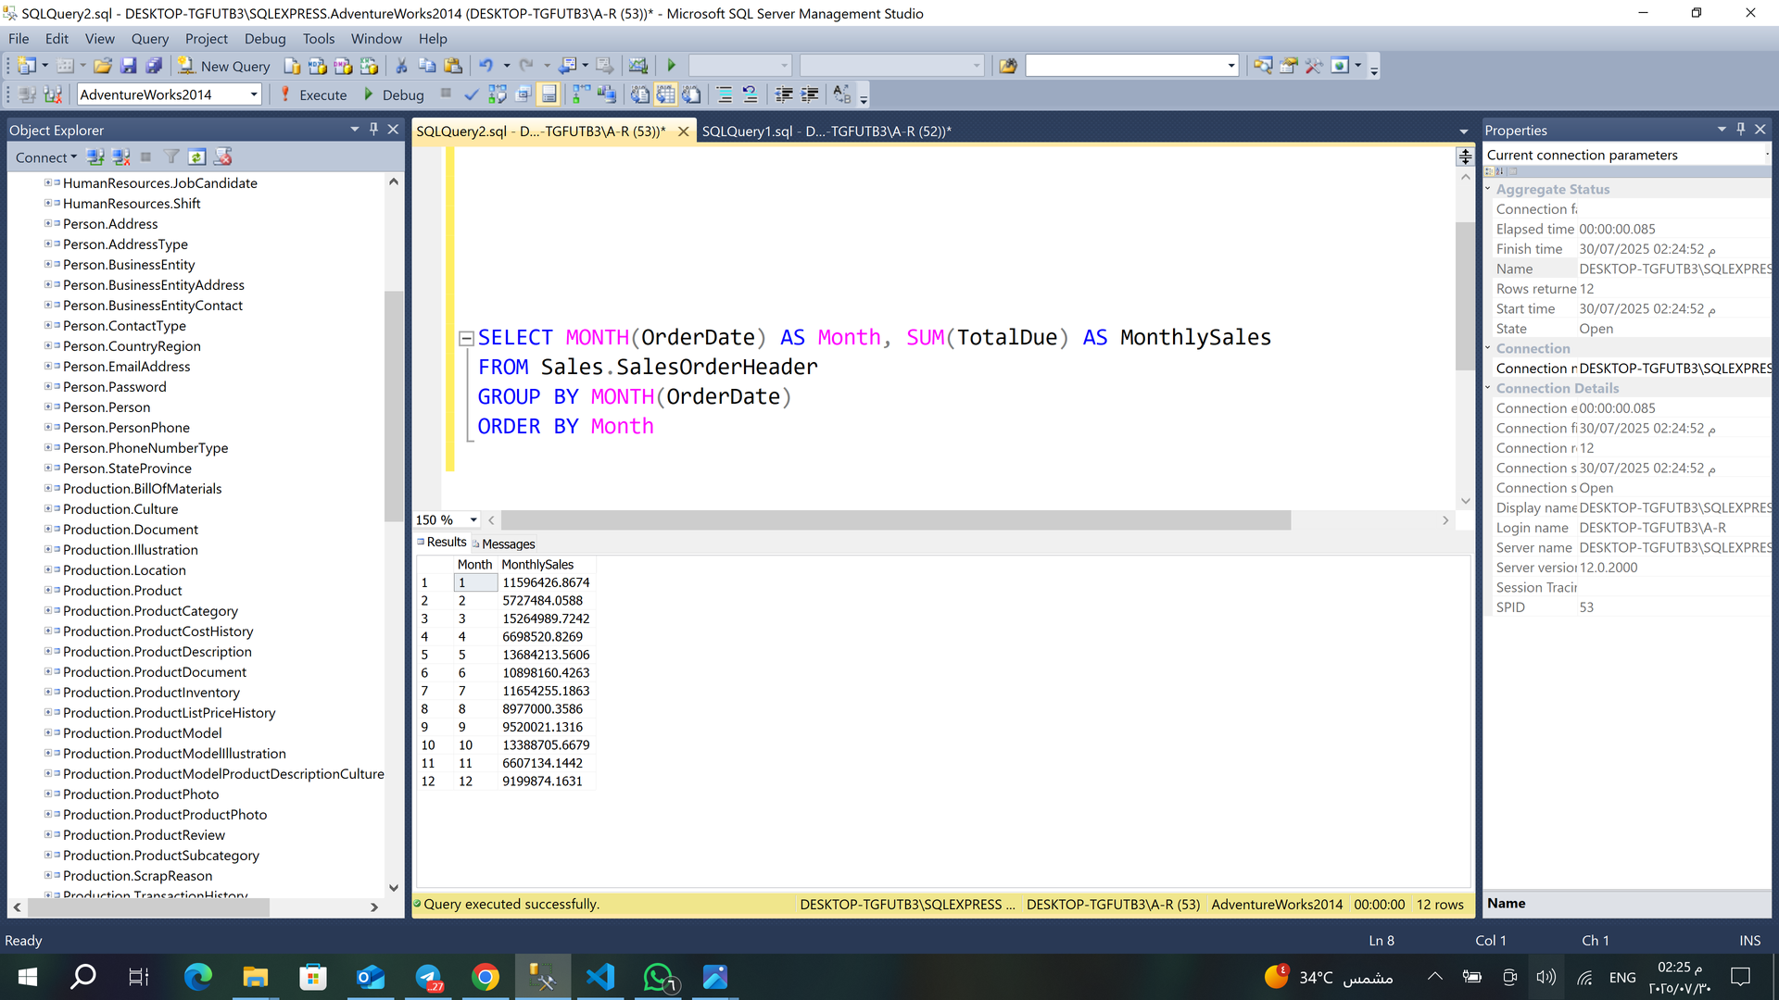
⏰ Step 4: Time-Based & Trend Analysis
What is the sales distribution by month of the year?

Slide 16
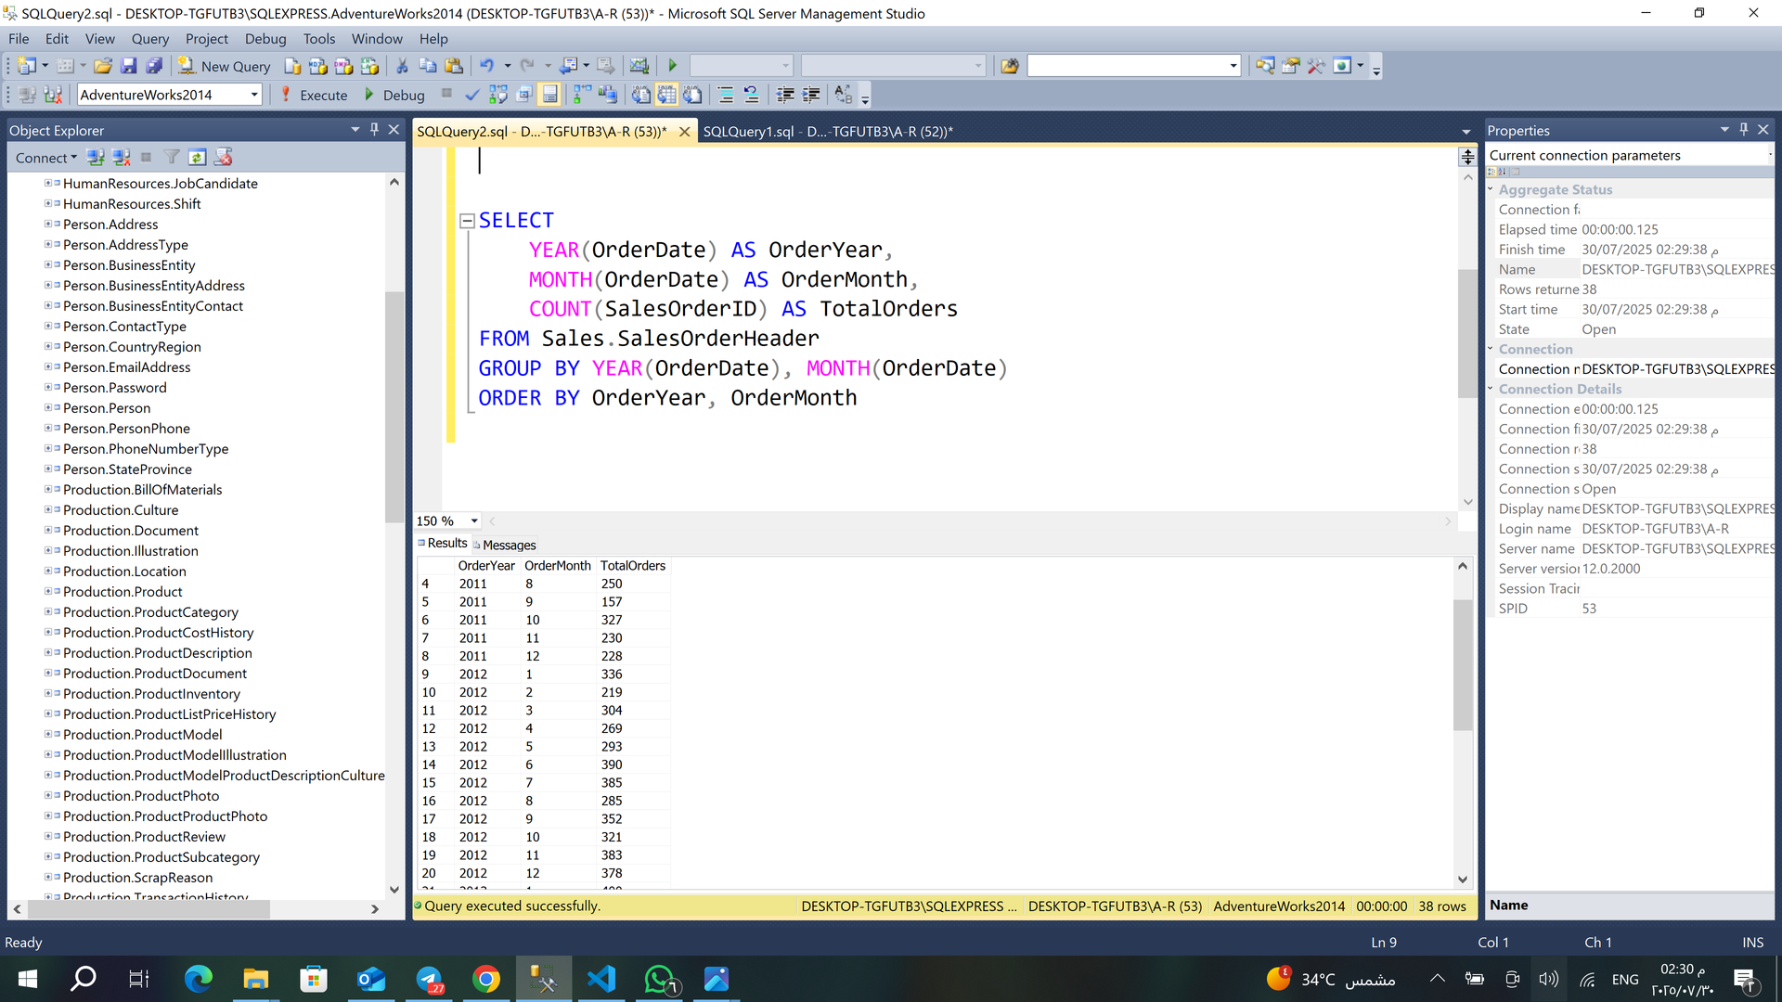
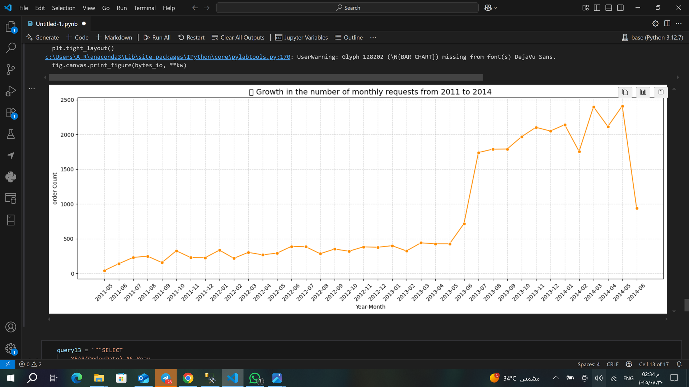
How many orders are placed each month?

Slide 17
💡 Step 5: Key Insights & Business Value
💡 1. Peak Order Periods Indicate Seasonal Opportunities
Significant spikes in total orders observed between June and December (2013–2014).
✅ Recommendation: Focus marketing efforts, promotions, and inventory buildup during these months to maximize revenue.
💡 2. Consistent Growth in New Customer Acquisition
A year-over-year increase in the number of new customers suggests effective outreach strategies.
✅ Recommendation: Continue investing in digital marketing channels and customer onboarding campaigns.

Slide 18
💡 3. Departments with Higher Average Tenure Indicate Stability
Departments such as Sales or Production show higher average years of service.
✅ Recommendation: Analyze employee retention factors in these departments and replicate best practices across others.
💡 4. Trend Analysis Can Enable Demand Forecasting
Order trends over months can be used to forecast future demand accurately.
✅ Recommendation: Implement predictive models to optimize stock levels and reduce overstock or shortages.

Slide 19
THANK YOU

